Slide 1

LAB 06 gruppo 64
Andrés Darìo Ortiz Beltran s305581
Federica Sorrentino s305719
Luca Liberatore s305639
Luca Scorrano s296047

Slide 2
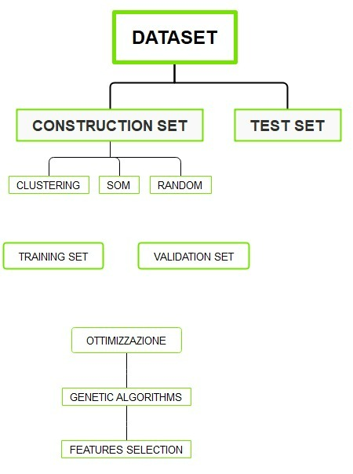
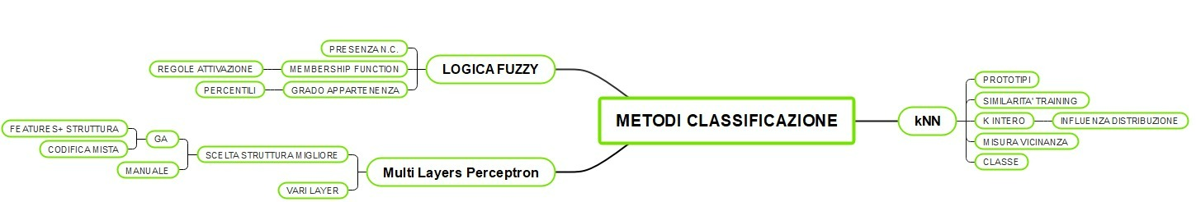
STAGES OF WORK

Slide 3
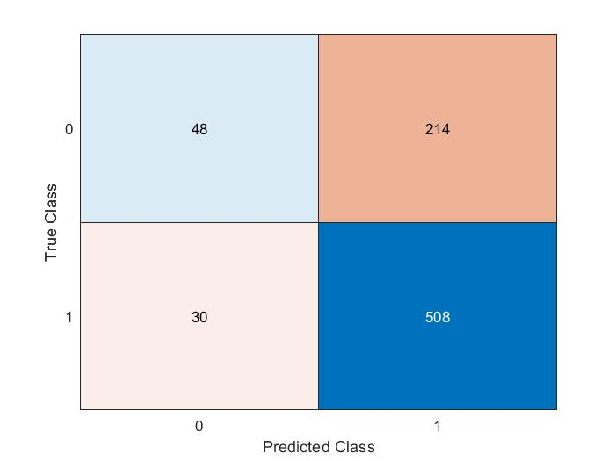
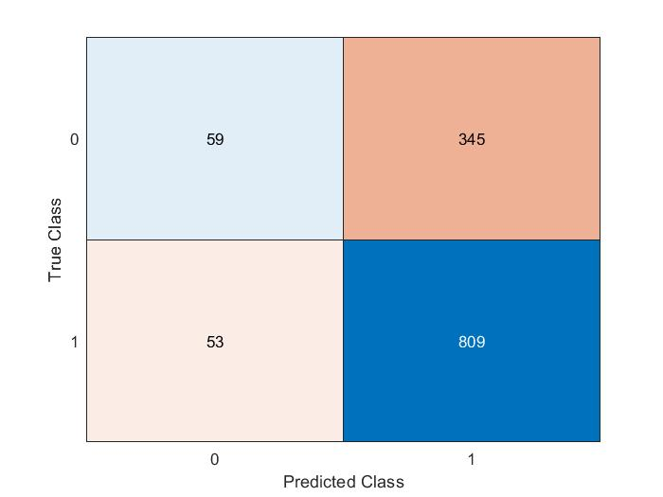
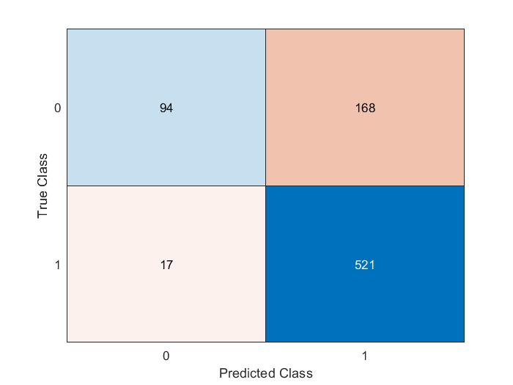
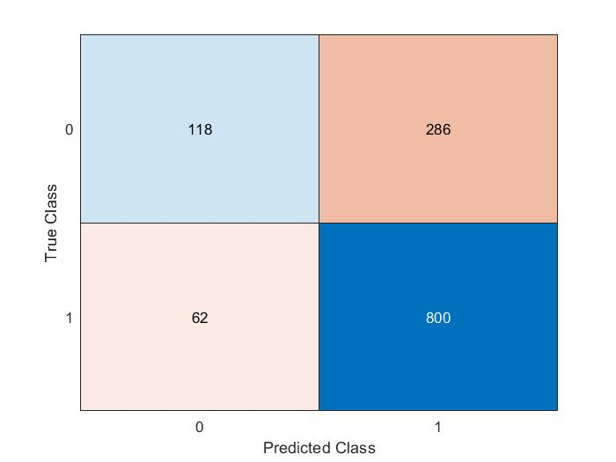
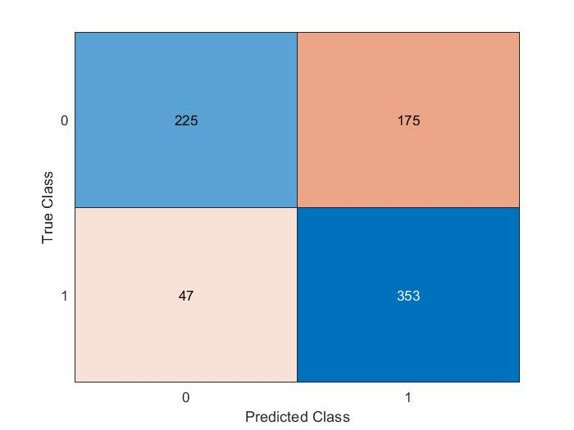
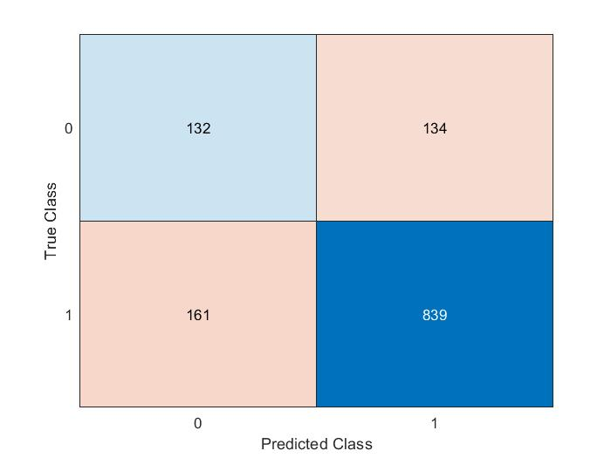
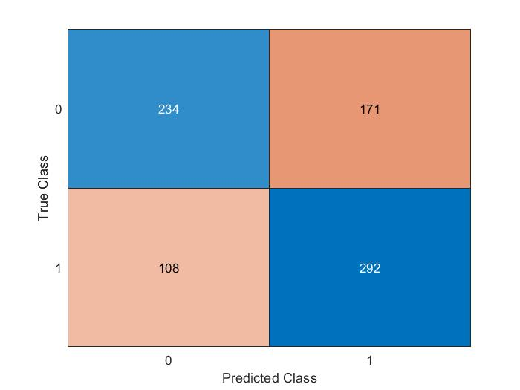
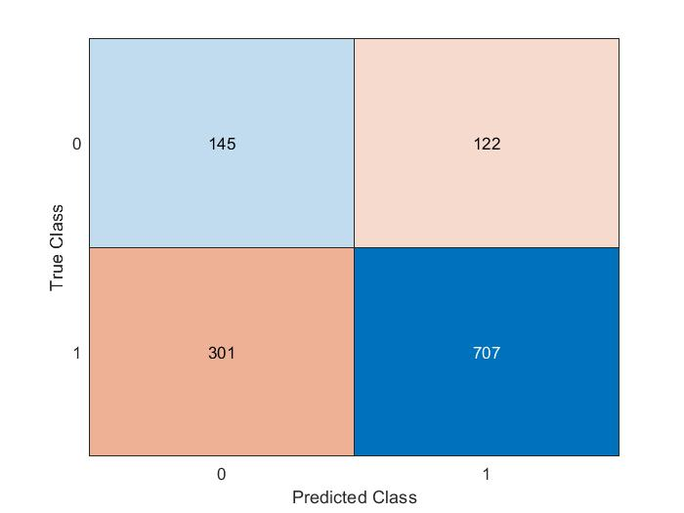



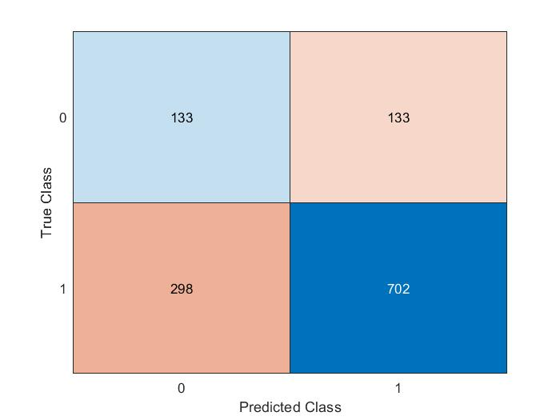
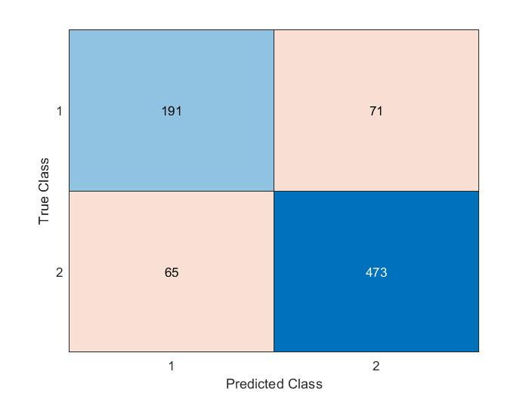
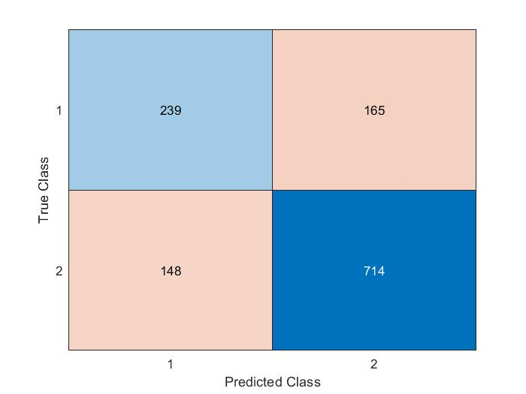
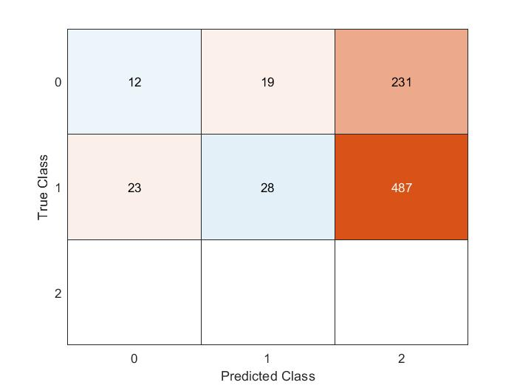

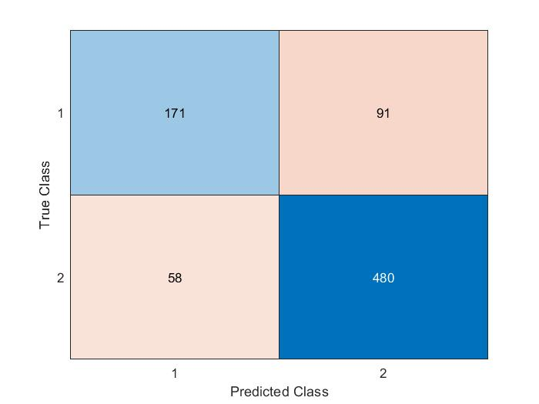
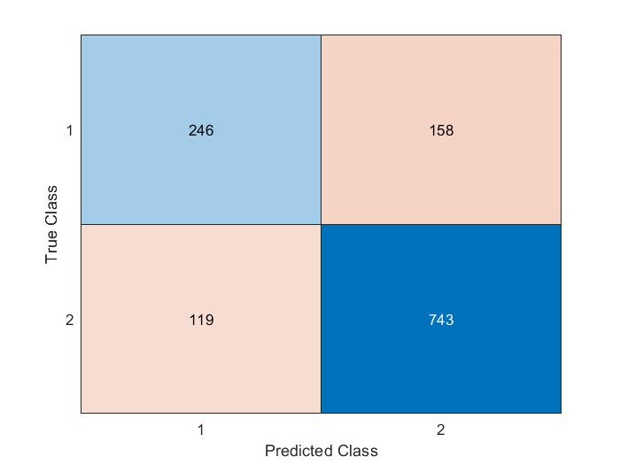
Codified variables
Yes/No variables
Training set
Validation set
Training set
Validation set
Random*
Random*
Hierarchicalclustering *
Hierarchicalclustering *
SOM*
SOM*
ANN –manual-
FIS
ANN –GA-
*kNN

Slide 4
PERFORMANCE COMPARISON-codified variables- % of correct classified of the class
Training set
Validation set
Random:
Training set Validation set
Class 0 18,3% 14,6%
Class 1 94,4% 93,8%
(800x6) (1266x6)
Dendrogram:
Training set Validation set
Class 0 57,8% 54,3%
Class 1 73% 70,1%
(800x6) (1266x6)
SOM:
Training set Validation set
Class 0 54,8% 50%
Class 1 70,5% 70,2%
(800x6) (1266x6)

Slide 5
PERFORMANCE COMPARISON-yes/no variables- % of correct classified of the class
Training set
Validation set
Random:
Training set Validation set
Class 0 35,9% 29,2%
Class 1 96,8% 92,8%
(800x23) (1266x23)
Dendrogram:
Training set Validation set
Class 0 56,2% 49,6%
Class 1 88,2% 83,9%
(800x23) (1266x23)
SOM:
Training set Validation set
Class 0 60,7% 62,5%
Class 1 85,2% 80,2%
(800x23) (1266x23)

Slide 6
PERFORMANCE COMPARISON-% of correct classified of the class
Training set
Validation set
FIS-codified:
Training set Validation set
Class 0 4,6% 6,2%
Class 1 5,2% 6,6%
(800x23) (1266x23)
ANN-manual-Y/N:
Training set Validation set
Class 0 72,9% 59,15%
Class 1 87,9% 82,3%
(800x23) (1266x23)
ANN-GA-Y/N:
Training set Validation set
Class 0 65,3% 60,9%
Class 1 89,2% 86,2%
(800x23) (1266x23)

Slide 7


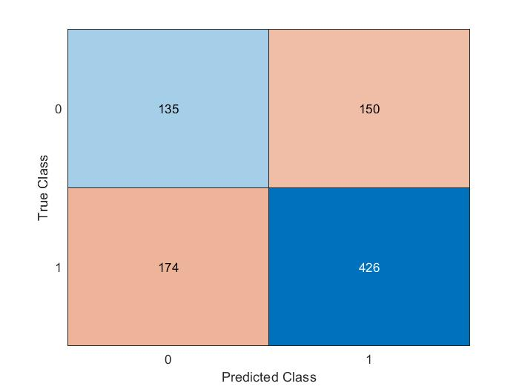
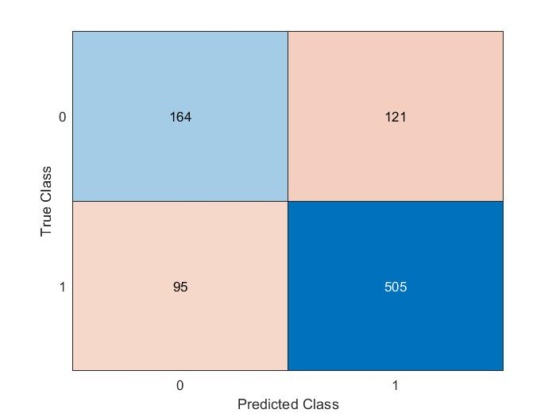


COMPARISON OF CLASSIFICATORS ON TEST SET- % of correct classified of the class
Codified variables
Yes/No variables
(885x6)
(885x23)
Class 0 13,3%
Class 1 94%
Random
Class 0 31,2%
Class 1 95,3%
(885x6)
(885x23)
Hierarchical clustering
Class 0 57,5%
Class 1 84,2%
Class 0 47,4%
Class 1 71%
(885x6)
(885x23)
Class 0 57,9%
Class 1 83,5%
Class 0 50,5%
Class 1 70,3%
SOM

Slide 8
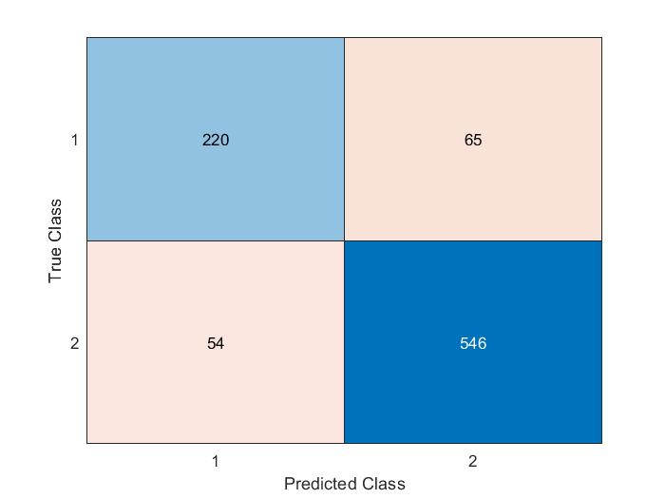
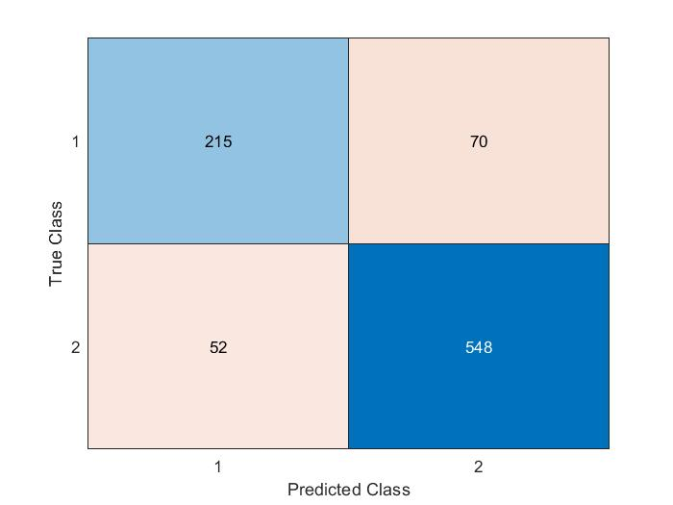

COMPARISON OF CLASSIFICATORS ON TEST SET- % of correct classified of the class
ANN-manual selection
(885x23)
Class 0 71,2%
Class 1 91%
ANN-GA selection
(885x27)
Class 0 75,4%
Class 1 91,3%
Class 0 4,9%
Class 1 4,2%
FIS (885x5)

Slide 9
THANKS FOR THE ATTENTION!

